Slide 1
Lesson 2: Introduction to Analysis of Algorithms: Discovering the Laws Governing Nature’s Computation
Input
Algorithm
Output

Slide 2
Wholeness of the Lesson
An algorithm is a procedure for performing a computation or deriving an output from a given set of inputs according to a specified rule.
By representing algorithms in a neutral language, it is possible to determine, in mathematical terms, the efficiency of an algorithm and whether one algorithm typically performs better than another.
Efficiency of computation is the hallmark of Nature’s self-referral performance. Contact with the home of all the laws of nature at the source of thought results in action that is maximally efficient and less prone to error.

Slide 3
What is Algorithm
An Algorithm is a finite set of precise instructions (steps) to solve a problem or to perform a computation.
You have learned various “discrete structures” and solved some smaller size problems using each structures.
Now, we would like to use multiple discrete structures and other techniques to solve more complex problems. In doing so, we need some clear steps to well manage such problems. Sequence of such steps is called the Algorithm.
Emdad Khan 6/9/15 3
Notes:
05/29/19
Prepared by Dr. Zakir H. Ahmed

Slide 4
How Algorithms are Used
There are many applications for Algorithms. In fact, you will need algorithms to solve almost all CS problems and the problems in the industry after you graduate.
A few examples are: finding the largest number in a sequence, searching a word from a list of words, finding whether a large number is prime or not, sorting a set of numbers, encryption and decryption for Internet security, ….
The key reason to learn Discrete Structure is to solve practical problems using Algorithms.
Emdad Khan 6/9/15 4
Notes:
05/29/19
Prepared by Dr. Zakir H. Ahmed

Slide 5


Example – finding maximum value
Describe an algorithm to find the maximum value in a finite sequence of integers
Basic Algorithm:
Emdad Khan 6/9/15 5
Notes:
05/29/19
Prepared by Dr. Zakir H. Ahmed

Slide 6
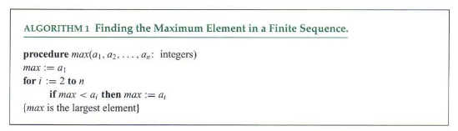
Example - finding maximum value
Algorithms finally needs to be implemented in software or hardware. In most case you will write a computer program.
Emdad Khan 6/9/15 6
Notes:
05/29/19
Prepared by Dr. Zakir H. Ahmed

Slide 7
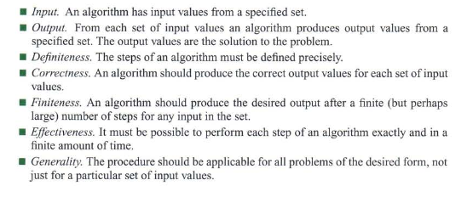
Properties of Algorithms
Algorithms have some key general properties:
Emdad Khan 6/9/15 7
Notes:
05/29/19
Prepared by Dr. Zakir H. Ahmed

Slide 8
Natural Things to Ask
How can we determine whether an algorithm is efficient ?
Correct ?
Given two algorithms that achieve the same goal, how can we decide which one is better? (E.g. sorting) Can our analysis be independent of a particular operating system or implementation in a language?
How can we express the steps of an algorithm without depending on a particular implementation?
Analysis of Algorithms

Slide 9
A Framework For Analysis of Algorithms
We will specify:
A simple neutral language for describing algorithms
A simple, general computational model in which algorithms execute
Procedures for measuring running time
A classification system that will allow us to categorize algorithms (a precise way of saying “fast”, “slow”, “medium”, etc)
Techniques for proving correctness of an algorithm
Analysis of Algorithms

Slide 10

Running Time
Most algorithms transform input objects into output objects.
The running time of an algorithm typically grows with the input size.
Average case time is often difficult to determine.
Often, we focus on the worst case running time.
  Easier to analyze
  Crucial to applications such as games, finance and robotics
Analysis of Algorithms

Slide 11

Running Time by Experiment
Write a program implementing the algorithm
Run the program with inputs of varying size and composition
Use a method like System.currentTimeMillis() to get an accurate measure of the actual running time
Optionally, plot the results
Analysis of Algorithms

Slide 12

Limitations of Experiments
It is necessary to implement the algorithm, which may be difficult
Results may not be indicative of the running time on other inputs not included in the experiment.
In order to compare two algorithms, the same hardware and software environments must be used
Analysis of Algorithms

Slide 13

Theoretical Analysis
Uses a high-level description of the algorithm instead of an implementation
Characterizes running time as a function of the input size, n.
Takes into account all possible inputs
Allows us to evaluate the speed of an algorithm independent of the hardware/software environment
Analysis of Algorithms

Slide 14
Pseudocode
Example: find max element of an array
High-level description of an algorithm
More structured than English prose
Less detailed than a program
Preferred notation for describing algorithms
Hides program design issues
Algorithm arrayMax(A, n)
Input array A of n integers
Output maximum element of A
currentMax ← A[0]
for i ← 1 to n − 1 do
if A[i] > currentMax then
currentMax ← A[i]
return currentMax
Analysis of Algorithms

Slide 15
Pseudocode Details
Control flow
  if … then … [else …]
  while … do …
  repeat … until …
  for … do …
  Indentation replaces braces
Method declaration
  Algorithm method (arg [, arg…])
  Input …
  Output …
Method call
  var.method (arg [, arg…])
Return value
  return expression
Expressions
  Assignment
  (like = in Java)
  Equality testing
  (like == in Java)
  n² Superscripts and other mathematical formatting allowed
Analysis of Algorithms

Slide 16
Exercises
Sorting algorithm: Translate into pseudo-code:
Given an array arr, create a second array arr2 of the same length.
To begin, find the min of arr, place it in position 0 of arr2, and remove min from arr
At the ith step, find the min of arr, place it in the next available position in arr2, and remove min from arr
Return arr2
(Assume that min and remove functions are available)
Palindrome algorithm: Transform into pseudo-code:
public boolean isPal(String s) {
if(s==null || s.length() <= 1) {
return true;
}
while(s.length() > 1){
if(s.charAt(0) !=
s.charAt(s.length()-1)){
return false;
}
s = s.substring(1,s.length()-1);
}
return true;
}
Analysis of Algorithms

Slide 17
Main Point
For purposes of examining, analyzing, and comparing algorithms, a neutral algorithm language is used, independent of the particularities of programming languages, operating systems, and system hardware. Doing so makes it possible to study the inherent performance attributes of algorithms, which are present regardless of implementation details. This illustrates the SCI principle that more abstract levels of intelligence are more comprehensive and unifying.
Analysis of Algorithms

Slide 18
The Random Access Machine (RAM) Model
A CPU
A potentially unbounded bank of memory cells, each of which can hold an arbitrary number or characters
2
1
0
Memory cells are numbered and accessing any cell in memory takes unit time.
Analysis of Algorithms

Slide 19

Primitive Operations
Basic computations performed by an algorithm
Identifiable in pseudocode
Largely independent from the programming language
Exact definition not important (we will see why later)
Assumed to take a constant amount of time in the RAM model
Analysis of Algorithms

Slide 20
Primitive Operations In This Course
  Performing an arithmetic operation (+, *, etc)
  Comparing two numbers
  Assigning a value to a variable
  Indexing into an array
  Calling a method
  Returning from a method
  Following an object reference
Analysis of Algorithms

Slide 21
Counting Primitive Operations
By inspecting the pseudocode, we can determine the maximum number of primitive operations executed by an algorithm, as a function of the input size
Algorithm arrayMax(A, n)
# operations
currentMax ← A[0] 2
m ← n − 1 2
for i ← 1 to m do 1 + n
if A[i] > currentMax then 2(n − 1)
currentMax ← A[i] 2(n − 1)
{ increment counter i } 2(n − 1)
return currentMax 1
Total 7n
Analysis of Algorithms

Slide 22

Estimating Running Time
Algorithm arrayMax executes 7n primitive operations in the worst case. Define:
  a = Time taken by the fastest primitive operation
  b = Time taken by the slowest primitive operation
Let T(n) be worst-case time of arrayMax. Then
a (7n) ≤ T(n) ≤ b(7n)
Hence, the running time T(n) is bounded by two linear functions
Analysis of Algorithms

Slide 23

Growth Rate of Running Time
Changing the hardware / software environment
  Affects T(n) by a constant factor, but
  Does not alter the growth rate of T(n)
The linear growth rate of the running time T(n) is an intrinsic property of algorithm arrayMax
Analysis of Algorithms

Slide 24
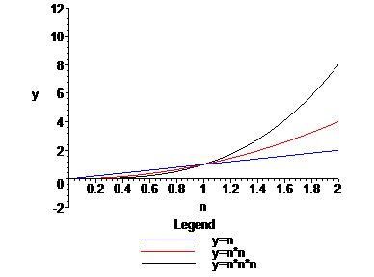
Growth Rates
Growth rates of functions:
  Linear ≈ n
  Quadratic ≈ n²
  Cubic ≈ n³
The graph of the cubic begins as the slowest but eventually overtakes the quadratic and linear graphs
Important factor for growth rates is the behavior as n gets large
Analysis of Algorithms

Slide 25
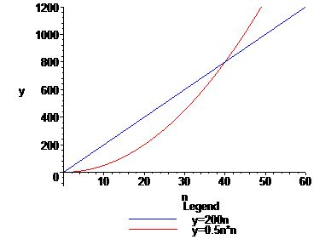
Constant Factors & Lower-order Terms
The growth rate is not affected by
  constant factors or
  lower-order terms
Example
  Compare 200*n with 0.5n*n
  Quadratic growth rate must eventually dominate linear growth
Analysis of Algorithms

Slide 26
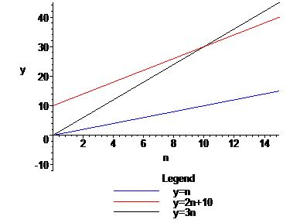
Big-Oh Notation (§1.2)
Given functions f(n) and g(n) defined on non-negative integers n, we say that f(n) is O(g(n)) (or “f(n) belongs to O(g(n))”) if there are positive constants c and n₀ such that
f(n) ≤ cg(n) for all n ≥ n₀
Example: 2n + 10 is O(n)
f(n) = 2n + 10
If g(n) = n, 3g(n) will eventually get bigger than f(n). We look for n₀, the point where the two graphs meet:
3n = 2n + 10
n = 10
It follows that for all n ≥ 10, f(n) ≤ 3g(n)
Analysis of Algorithms

Slide 27
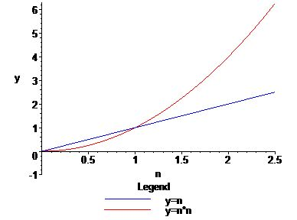
Big-Oh Example
Example: n² is not O(n)
Proof
For each c and n₀, we need to find an n ≥ n₀ such that n² > cn.
Can do this by letting n be any integer bigger than both n₀ and c. Then
n² = n * n > c * n
Analysis of Algorithms

Slide 28

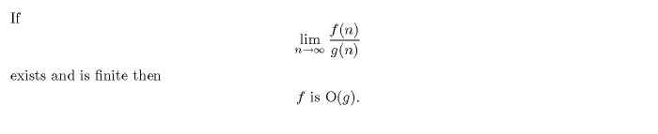

More Big-Oh Examples
n is O(2n+1)
nlog n + n is O(nlog n)
Fact (for students who are familiar with “limits”):
Example:
3n² + 1 is O(2n² + n)
Analysis of Algorithms

Slide 29
Big-Oh and Growth Rate
The big-Oh notation gives an upper bound on the growth rate of a function
The statement “f(n) is O(g(n))” means that the growth rate of f(n) is no more than the growth rate of g(n)
Example: Neither of the functions 2n nor 2n² grows any faster (asymptotically) than n². Therefore, both functions belong to O(n²)
Analysis of Algorithms

Slide 30
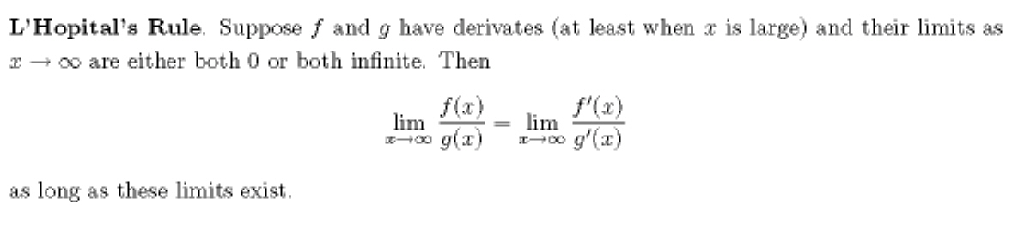
Standard Complexity Classes
The most common complexity classes used in analysis of algorithms are, in increasing order of growth rate:
O(1), O(log n), O(n^{1/k}), O(n), O(nlog n), O(n^{k}) (k > 1),
O(2^{n}), O(n!), O(n^{n})
Functions that belong to classes in the first row are known as polynomial time bounded.
Verification of the relationships between these classes can be done most easily using limits, sometimes with L’Hopital’s Rule
Analysis of Algorithms

Slide 31
Optional Examples Using Limits
lim_{n}(3n² + 2n – 4 / n²) is finite ( = 3), so
3n² + 2n – 4 is O(n²).
lim_{n} (n^{1/2} / n) = 0 so n^{1/2} is O(n)
but lim_{n} (n / n^{1/2}) is infinite, so n is not O(n^{1/2})
lim_{n} (log n / n^{1/2}) = 0, so log n is O(n^{1/2})
but lim_{n} (n^{1/2} / log n) is infinite, so n^{1/2} is not O(log n)
lim_{n} (n^{k} / 2^{n}) = 0, so n^{k} is O(2^{n}) (for any k > 0)
but lim_{n} (2^{n} / n^{k}) is infinite, so 2^{n} is not O(n^{k})
Analysis of Algorithms

Slide 32

Big-Oh Rules
If f(n) a polynomial of degree d, say,
f(n) = a₀ + a₁ n + … + a_{d} n^{d}, then f(n) is O(n^{d}):
  Drop lower-order terms (those of degree less than d)
  Drop constant factors (in this case, a_{d} )
  See first example on previous slide
Guidelines:
  Use the smallest possible class of functions
  E.g. Say “2n is O(n)” instead of “2n is O(n²)”
  Use the simplest expression of the class
  E.g. Say “3n + 5 is O(n)” instead of “3n + 5 is O(3n)”
Analysis of Algorithms

Slide 33
Asymptotic Algorithm Analysis
The asymptotic analysis of an algorithm determines the running time in big-Oh notation
To perform the (worst-case) asymptotic analysis
  We find the worst-case number of primitive operations executed as a function of the input size
  We express this function with big-Oh notation
Example:
  We determined that algorithm arrayMax executes at most 7n primitive operations
  Since 7n is O(n), we say that algorithm arrayMax “runs in O(n) time”
Analysis of Algorithms

Slide 34
Basic Rules For Computing Asymptotic Running Times
Rule-1: For Loops
The running time of a for loop is at most the running time of the statements inside the loop (including tests) times the number of iterations (see arrayMax)
Rule-2: Nested Loops
Analyze from inside out. The total running time of a statement inside a group of nested loops is the running time of the statement times the sizes of all the loops
for i ← 0 to n-1 do
for j ← 0 to n-1 do
k ← i + j
(Runs in O(n²) )
Analysis of Algorithms

Slide 35
(continued)
Rule-3: Consecutive Statements
Running times of consecutive statements should be added in order to compute running time of the whole
for i ← 0 to n-1 do
a[i] ← 0
for i ← 0 to n-1 do
for j ← 0 to i do
a[i] ← a[i] + i + j
(Running time is O(n) + O(n²). By an exercise, this is O(n²) )
Analysis of Algorithms

Slide 36
(continued)
Rule-4: If/Else
For the fragment
if condition then
S1
else
S2
the running time is never more than the running time of the condition plus the larger of the running times of S1 and S2.
Analysis of Algorithms

Slide 37
Example: Removing Duplicates From An Array
The problem: Given an array of n integers that lie in the range 0..2n - 1, return an array in which all duplicates have been removed.
Analysis of Algorithms

Slide 38
Remove Dups, Algorithm
Algorithm removeDups(A,n)
Input: An array A with n > 0 integers in the
range 0..2n-1
Output: An array with all duplicates in A removed
W ← new Array(2n) //for bookkeeping
B ← new Array(n) //assume both initialized with 0’s
index ← 0
for i ← 0 to n-1 do
u ← A[i]
W[u] ← W[u] + 1
if W[u] = 1 then //means a new value
B[index] ← A[i]
index ← index + 1
//next: eliminate extra 0s at the end
C ← new Array(index)
for j ← 0 to index do
C[j] ← B[j]
return C
Analysis
T = running time of removeDups
O(n) initialization +
single for loop of size n +
O(n) copy operation
=>
T(n) is 3 * O(n) = O(n)
Therefore, the running time of Algorithm #3 is O(n)
Analysis of Algorithms

Slide 39
Main Point
One can improve the running time of the "remove duplicates" algorithm from O(n²) to O(n) by introducing a tracking array as a means to encapsulate "bookkeeping" operations (this can be done more generally using a hashtable). This technique is reminiscent of the Principle of the Second Element from SCI: To remove the darkness, struggling at the level of darkness is ineffective; instead, introduce a second element – namely, light. As soon as the light is introduced, the problem of darkness disappears.
Analysis of Algorithms

Slide 40

Relatives of Big-Oh
big-Omega
  f(n) is Ω(g(n)) if g(n) is O(f(n)).
big-Theta
  f(n) is Θ(g(n)) if f(n) is both O(g(n)) and Ω(g(n)).
little-oh
  f(n) is o(g(n)) if, for any constant c > 0, there is an integer constant n₀ ≥ 0 such that f(n) ≤ cg(n) for all n ≥ n₀
  In case lim_{n}(f(n)/g(n)) exists, f(n) is o(g(n)) iff the limit = 0.
Analysis of Algorithms

Slide 41

Intuition for Asymptotic Notation
big-Oh
  f(n) is O(g(n)) if f(n) is asymptotically less than or equal to g(n)
big-Omega
  f(n) is Ω(g(n)) if f(n) is asymptotically greater than or equal to g(n)
big-Theta
  f(n) is Θ(g(n)) if f(n) is asymptotically equal to g(n)
little-oh
  f(n) is o(g(n)) if f(n) is asymptotically strictly less than g(n)
Analysis of Algorithms

Slide 42

Examples of the Relatives of Big-Oh
5n² is Ω(n²) and therefore, 5n² is Θ(n²)
  f(n) is Ω(g(n)) iff g(n) is O(f(n)) iff there is a constant c > 0 and an integer constant n₀ ≥ 1 such that g(n) ≤ c • f(n) for all n ≥ n₀
  So 5n² is Ω(n²) iff n² is O(5n²), which is obviously true.
  To show 5n² is Θ(n²), must show also that 5n² is also O(n²) – this is also obvious.
  Therefore 5n² is Θ(n²)
5n is o(n²) but 5n is not o(n)
Need to show that for any positive c, 5n ≤ cn² for large enough n.
This inequality holds whenever n ≥ 5/c.
Therefore, to prove that 5n is o(n²), given any positive c, pick n₀ bigger than 5/c.
Then for all n ≥ n_{0,} 5n ≤ cn²
To show 5n is not o(n), we must find positive c so that for every choice of n₀,
there is an n ≥ n₀ for which 5n > cn.
This is obviously true: let c = 1, and given n₀, choose n = n₀.
Analysis of Algorithms

Slide 43
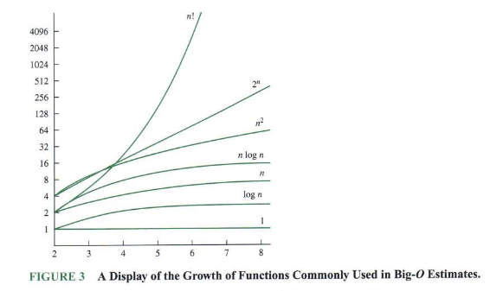
More on Big-Oh (from Corman)
Emdad Khan 43
Notes:
05/29/19
Prepared by Dr. Zakir H. Ahmed

Slide 44

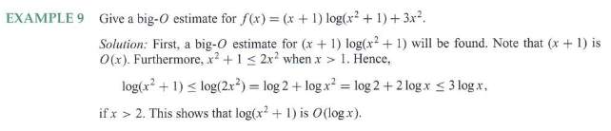

More on Big O (from Corman)
Emdad Khan 44
Notes:
05/29/19
Prepared by Dr. Zakir H. Ahmed

Slide 45
Optional: Limit characterizations of big-oh and little-oh
Even if limits do not exist, there are ways to characterize big-oh and little-oh using limit concepts
f is O(g) if and only if there is some number M > 0 such that for all n,
f(n) / g(n) < M
(Equivalently, iff limsup_{n} f(n)/g(n) is finite)
f is o(g) if and only if f is O(g) and every convergent subsequence of {f(n)/g(n)}_{n} converges to 0.
Question: Suppose g(n) = 1 for all n, and f(n) is 0 for n even,
f(n) is 1 for n odd. Is f in O(g)? In o(g)?
Analysis of Algorithms

Slide 46
Running Time of Recursive Algorithms
Problem: Given an array of integers in sorted order, is it possible to perform a search for an element in such a way that no more than half the elements of the array are examined? (Assume the array has 8 or more elements.)
Analysis of Algorithms

Slide 47
Binary Search
Algorithm search(A,x)
Input: An already sorted array A with n elements and search value x
Output: true or false
return binSearch(A, x, 0, A.length-1)
Analysis of Algorithms

Slide 48
(continued)
Algorithm binSearch(A, x, lower, upper)
Input: Already sorted array A of size n, value x to be
searched for in array section A[lower]..A[upper]
Output: true or false
if lower > upper then return false +1
mid ← (upper + lower)/2 +3
if x = A[mid] then return true +2
if x < A[mid] then +2
return binSearch(A, x, lower, mid – 1)
else
return binSearch(A, x, mid + 1, upper) +3 + T(n/2)
_________________________________________________________________________
For the worst case (x is above all elements of A and n a power of 2), running time is given by
the Recurrence Relation: (In this case, right half is always half the size of the original.)
T(1) = 11; T(n) = 11 + T(n/2)
Analysis of Algorithms

Slide 49
Solving Recurrences
Substitution (Guessing) method
Iteration method
Master method
Emdad Khan

Slide 50
Solving A Recurrence Relation: The Guessing Method
T(1) = 11
T(2) = 11 + 11
T(4) = 11 + 11 + 11
T(8) = 11 + 11 + 11 + 11
T(2^{m}) = 11 * m + 11
T(n) = 11 * log n + 11, which is O(log n)
Guessing method requires us to guess the general formula from a few small values. This is not always possible to do (we will discuss an alternative method in a later lecture)
When using the guessing method, final formula should be verified. Often this is done by induction, though in simple cases, a direct verification is possible.
Analysis of Algorithms

Slide 51
Verification of Formula
Claim The function f(n) = 11 * log n + 11 is a solution to the recurrence
T(1) = 11; T(n) = T(n/2) + 11 (n a power of 2)
Proof: Prove that whenever n is a power of 2, f(n) satisfies the recurrence. Since n is a power of 2, we write n = 2^{m}. Treating n as a power of 2, f(n) can be written as
f(2^{m}) = 11 * m +11.
We must show that f(1) = 11 and f(2^{m}) = f(2^{m-1}) + 11
For n = 1, we have:
f(1) = 11 * log 1 + 11 = 11
In general,
f(2^{m}) = 11 * m + 11
= 11 * (m-1) + 11 + 11
= (11 * (m-1) + 11) + 11
= f(2^{m-1}) + 11,
as required.
(Note: Induction is not required in this case.)
Analysis of Algorithms

Slide 52
Additional Points About the Guessing Method
To state results (so far) correctly, it’s necessary for n to be a power of 2. But we wish to have a bound on running time for any n – what can be done?
In all cases that concern us, T is well enough behaved (as is the complexity function log n) between successive powers of 2 to permit us to conclude that, if we know the asymptotic running time, assuming n is a power of 2, the running time for all n, not necessarily a power of 2, must belong to this same complexity class.
Analysis of Algorithms

Slide 53
Optional: Not a Power of 2 – Main Result
A number-theoretic function f(n) is smooth if f(n) is eventually nondecreasing and if f(2n) is Θ (f(n))
Theorem. Suppose f(n) is smooth and
T(n) is eventually nondecreasing. Then
if T(n) is Θ(f(n)) for n a power of 2, T(n)
is Θ(f(n)).
Analysis of Algorithms

Slide 54
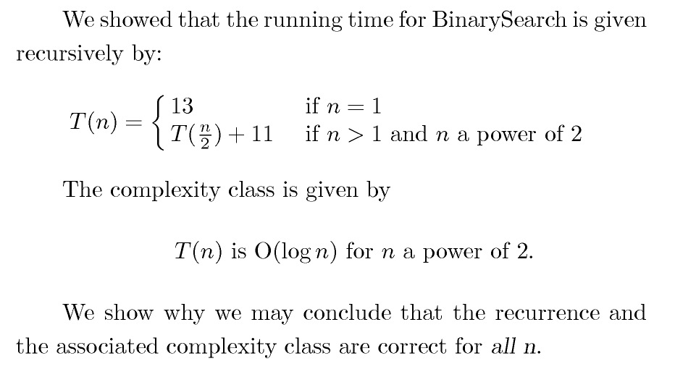
Optional: Computing T(n) for Recursive Algorithms, n Not a Power of 2
Analysis of Algorithms

Slide 55
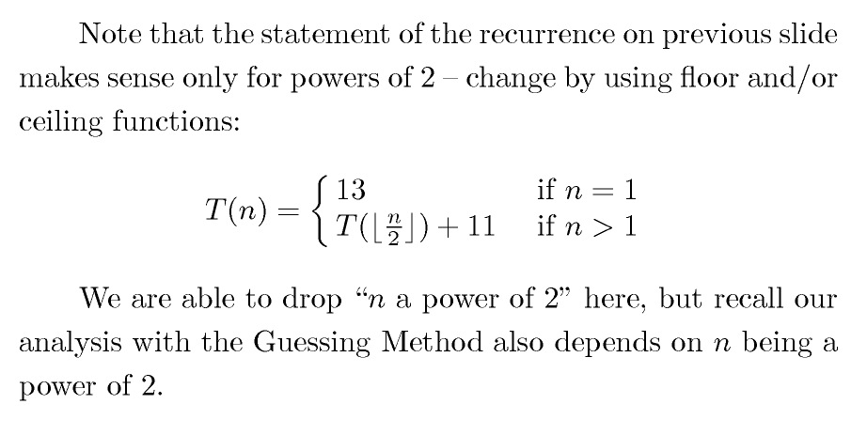
Optional: Not a Power of 2 (continued)
Analysis of Algorithms

Slide 56
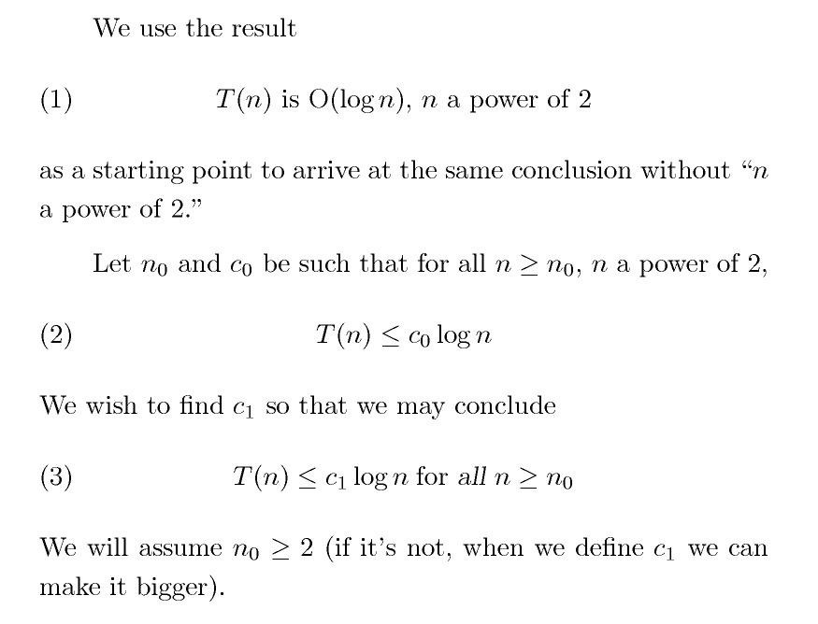
Optional: Not a Power of 2 (continued)
Analysis of Algorithms

Slide 57
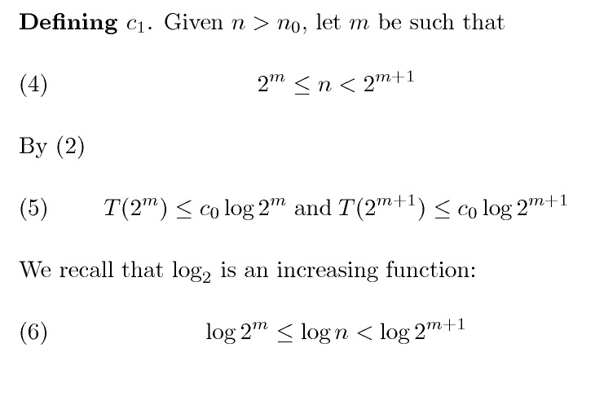
Optional: Not a Power of 2 (continued)
Analysis of Algorithms

Slide 58
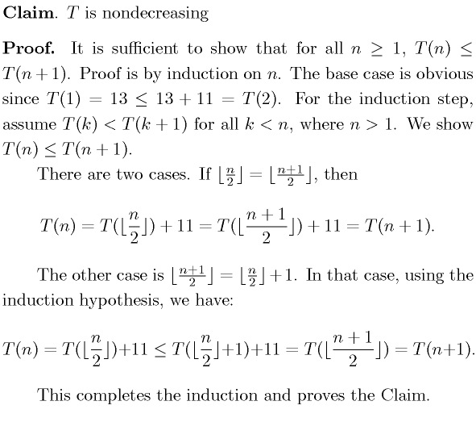
Optional: Not a Power of 2 (continued)
Analysis of Algorithms

Slide 59
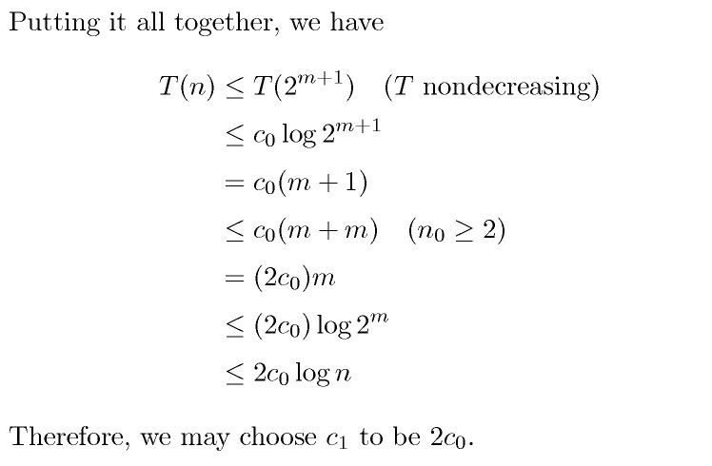
Optional: Not A Power of 2 (continued)
Analysis of Algorithms

Slide 60
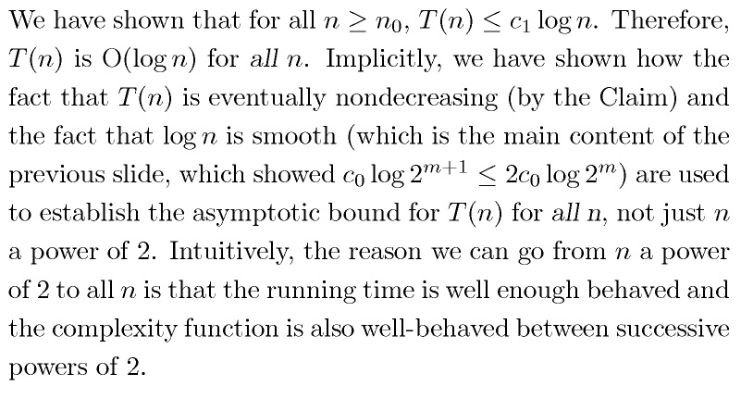
Optional: Not a Power of 2 (continued)
Analysis of Algorithms

Slide 61
The Divide and Conquer Algorithm Strategy
The binary search algorithm is an example of a “Divide And Conquer” algorithm, which is typical strategy when recursion is used.
The method:
  Divide the problem into subproblems (divide input array into left and right halves)
  Conquer the subproblems by solving them recursively (search recursively in whichever half could potentially contain target element)
  Combine the solutions to the subproblems into a solution to the problem (return value found or indicate not found)
Analysis of Algorithms

Slide 62
Main Point
Recurrence relations are used to analyze recursively defined algorithms. Just as recursion involves repeated self-calls by an algorithm, so the complexity function T(n) is defined in terms of itself in a recurrence relation. Recursion is a reflection of the self-referral dynamics at the basis of Nature’s functioning. Ultimately, there is just one field of existence; everything that happens therefore is just the dynamics of this one field interacting with itself. When individual awareness opens to this level of Nature’s functioning, great accomplishments become possible.
Analysis of Algorithms

Slide 63
Another Technique To Solve Recurrences: Iteration Method (Counting Self-Calls)
To determine the running time of a recursive algorithm, another often-used technique is counting self-calls.
Often, processing time in a recursion, apart from self-calls, is constant. In such cases, running time is proportional to the number of self-calls.
Analysis of Algorithms

Slide 64

s(n) =
c + s(n-1)
c + c + s(n-2)
2c + s(n-2)
2c + c + s(n-3)
3c + s(n-3)
…
kc + s(n-k) = ck + s(n-k)

Slide 65
So far for n >= k we have
  s(n) = ck + s(n-k)
What if k = n?
  s(n) = cn + s(0) = cn

Slide 66
So far for n >= k we have
  s(n) = ck + s(n-k)
What if k = n?
  s(n) = cn + s(0) = cn
So
Thus in general
  s(n) = cn

Slide 67
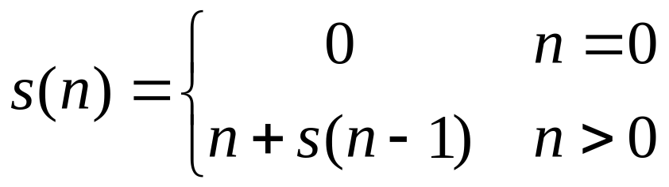
s(n)
= n + s(n-1)
= n + n-1 + s(n-2)
= n + n-1 + n-2 + s(n-3)
= n + n-1 + n-2 + n-3 + s(n-4)
= …
= n + n-1 + n-2 + n-3 + … + n-(k-1) + s(n-k)

Slide 68
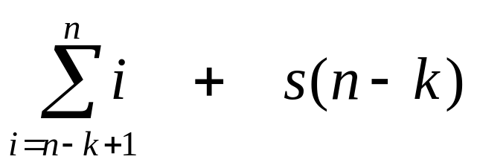
s(n)
= n + s(n-1)
= n + n-1 + s(n-2)
= n + n-1 + n-2 + s(n-3)
= n + n-1 + n-2 + n-3 + s(n-4)
= …
= n + n-1 + n-2 + n-3 + … + n-(k-1) + s(n-k)
=

Slide 69
So far for n >= k we have

Slide 70
So far for n >= k we have
What if k = n?

Slide 71
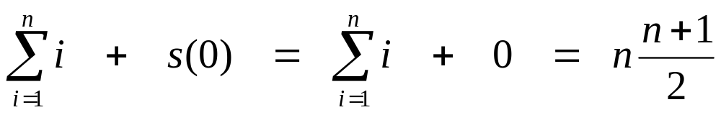
So far for n >= k we have
What if k = n?

Slide 72
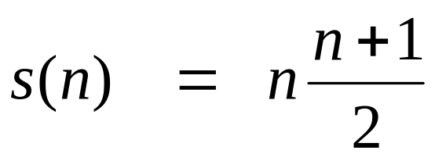
So far for n >= k we have
What if k = n?
Thus in general

Slide 73
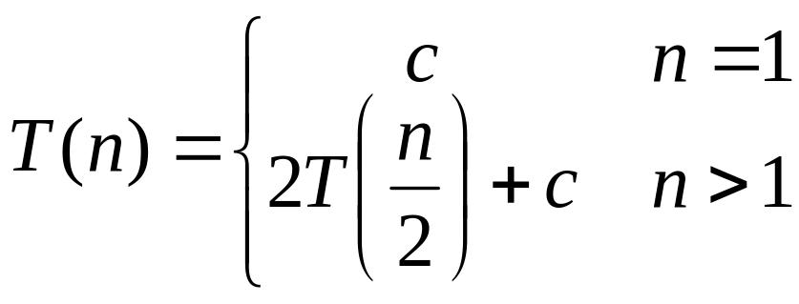
T(n) =
2T(n/2) + c
2(2T(n/2/2) + c) + c
2²T(n/2²) + 2c + c
2²(2T(n/2²/2) + c) + 3c
2³T(n/2³) + 4c + 3c
2³T(n/2³) + 7c
2³(2T(n/2³/2) + c) + 7c
2⁴T(n/2⁴) + 15c
…
2^{k}T(n/2^{k}) + (2^{k} - 1)c

Slide 74
So far for n > 2k we have
  T(n) = 2^{k}T(n/2^{k}) + (2^{k} - 1)c
What if k = lg n?
  T(n) = 2^{lg n} T(n/2^{lg n}) + (2^{lg n} - 1)c
  = n T(n/n) + (n - 1)c
  = n T(1) + (n-1)c
  = nc + (n-1)c = (2n - 1)c

Slide 75
Example of Counting Self-Calls: The Fib Algorithm
The Fibonacci numbers are defined recursively by:
F(0) = 0, F(1) = 1, F(n) = F(n-1) + F(n-2)
This is a recursive algorithm for computing the nth
Fibonacci number:
  Algorithm fib(n)
  Input: a natural number n
    Output: F(n)
if (n = 0 || n = 1) then return n
return fib(n-1) + fib(n-2)
Analysis of Algorithms

Slide 76
(continued)
Lemma. For n>1, the number S(n) of self-calls in fib(n) is ≥ F(n)
Proof. By Total Induction. [Review the method of Total Induction]
Base Case n=2. In this case S(2) = 1 (fib(n-2) is not reached), but F(2) = 1.
Induction Step
- Assume the result for all k < n.
- Therefore, number S(n-1) of self-calls for fib(n-1) is ≥ F(n-1), for
fib(n-2) is ≥ F(n-2).
- Therefore, number S(n) of self-calls for fib(n) is
≥ F(n-1)+F(n-2)
=F(n)
Lemma. For all n > 4, F(n) > (4/3)^{n} Proof. Exercise!
==================================
Therefore, the running time of the fib algorithm is Ω(r^{n}) for some
r >1. In other words, fib is an exponentially slow algorithm!
Analysis of Algorithms

Slide 77
Binary Search, Counting Self-Calls
We can compute asymptotic running time of Binary Search using the technique of counting self-calls.
Observation: Suppose n is a power of 2 – say n = 2^{m}. Then the number of terms in the sequence
2^{m}, 2^{m-1}, 2^{m-2}, . . ., 2¹, 2⁰=1
is m +1 = 1+log n.
In the worst case for BinarySearch, input size n = 2^{m} is a power of 2 and is cut exactly in half with each successive self-call. Therefore, the successive input sizes of self-calls is 2^{m-1}, 2^{m-2}, . . ., 2¹, 2⁰=1, so log n self-calls are made. Running time is therefore O(log n)
Analysis of Algorithms

Slide 78
Descending Sequences
We observed that if n is a power of 2 – say n = 2^{m}. Then the number of terms in the sequence
2^{m}, 2^{m-1}, 2^{m-2}, . . ., 2¹, 2⁰=1
is m +1 = 1+log n.
A more general fact that can be proved using this observation is if n is any positive integer, the sequence of terms
n, n/2, n/4, . . . , n/2^{m} = 1
where m is the largest power of 2 that is n, has exactly 1 + m = 1 + ⎣log n⎦ terms
Analysis of Algorithms

Slide 79
Proving Correctness: Iterative Algorithms
To prove an algorithm is correct, we view it as a machine that transforms input data to output data. The input data are expected to satisfy certain requirements (called preconditions) and the output data are also expected expected to satisfy certain requirements (called postconditions).
A proof of correctness is a proof that, whenever input data for an algorithim satisfy the preconditions, the output data satisfy the postconditions.
Example
Algorithm add(m,n)
Input: Two integers m, n
Output: m + n
z ← m + n
return z
Here, the precondition is: m and n are integers. The postcondition is: returned value is the sum of m and n.
Proof of Correctness: Assume m and n are integers, so that the precondition is satisfied. As the algorithm executes, z is populated with the value m + n. The return value is z, which is the sum m+n, so the postcondition is satisfied.
Analysis of Algorithms

Slide 80
(continued)
In a careful demonstration of correctness, the algorithm is broken down into sections. Postconditions for one section become preconditions of next section. The proof of correctness will then show that within each section, under the assumption that preconditions hold for the section, the algorithm’s output for that section satisfies the postconditions.
In practice, for iterative algorithms, all that is necessary is to establish that the “goal” of each loop in the algorithm is achieved. This is done with the technique of loop invariants.
Analysis of Algorithms

Slide 81
Loop Invariants
Definition of Loop Invariant: A loop invariant I(i) is a statement depending on the iterator i, which holds true at the completion of the ith pass through the loop.
Theorem: A loop will be correct relative to its pre- and post-conditions if each of the following is true about its loop invariant I(i)
I(k) is true at end of the i=k pass for each k in the range of i. (This is verified by induction.)
If the loop terminates after finitely many iterations, the truth of the loop invariant ensures the truth of the postcondition of the loop
Algorithm iterativeFactorial(n)
Input: A non-negative integer n
Output: n!
if (n = 0 || n = 1) then
return 1
accum ← 1
for i ← 1 to n do
accum ← accum * i
return accum
Example: Loop invariant here is:
I(i): accum = i!
Analysis of Algorithms

Slide 82
Proof of Correctness
Proof of correctness:
We identify the loop invariant for the for loop as before: I(i): accum = i!
We verify by induction on i that I(k) holds at the end of the i = k pass, for 1 ≤ k ≤ n.
Base Case. After the iteration i = 1 completes, accum has value 1 = 1!.
Induction Step. Assuming I(k) holds, show I(k+1) holds. Because I(k) is true, at the end of the i = k pass, accum = k!. Then, at the end of the i = k+1 pass, we have:
Algorithm iterativeFactorial(n)
Input: A non-negative integer n
Output: n!
if (n = 0 || n = 1) then
return 1
accum ← 1
for i ← 1 to n do
accum ← accum * i
return accum
accum = accum * i = accum * (k+1) = k! * k+ 1 = k+1!
This shows that the loop invariant is true for all k for which
1 ≤ k ≤ n . In particular, the value stored in accum after the
k = n pass is n!, and this is the value that the algorithm returns. Therefore, iterativeFactorial correctly computes n! on input n.
Analysis of Algorithms

Slide 83
Proving Correctness: Recursive Algorithms
The strategy for proving correctness of a recursive algorithm involves the following steps:
1. Verify that the recursion is valid: there should be a base case and recursive calls must eventually lead to the base case
2. Show that the values given by the base case are correct outputs for the function
3. Show that, if you assume the output value of the algorithm on input j is correct, for all j < n, then output value on input n is correct.
Analysis of Algorithms

Slide 84
Example of Correctness Proof for a Recursive Algorithm
Proof of Correctness
Valid Recursion Base case is “n= 0 or n=1”. Each self-call reduces input size by 1, so eventually base case is reached
Base The values 0! and 1! are correctly computed by the base case
Recursion Assuming recursiveFactorial(n-1) correctly computes n-1!, we must show output of recursiveFactorial(n) is correct. But output of recursiveFactorial(n) is
n * recursiveFactorial(n-1) = n!, as required.
Therefore, the algorithm correctly computes n! for every n.
Algorithm recursiveFactorial(n)
Input: A non-negative integer n
Output: n!
if (n = 0 || n = 1) then
return 1
return n * recursiveFactorial(n-1)
Analysis of Algorithms

Slide 85
Another Example: McCarthy’s 91
Algorithm mc91(n)
Input: A positive integer n
Output: 91 if n <= 101,
n-10 otherwise
if n > 100 then
return n - 10
return mc91(mc91(n+11))
Here, proof that this is a valid recursion is not obvious. It is necessary to prove the output is right in order to prove that the recursion is valid – not easy to separate these two validation points.
Optional Exercise: Prove mc91 is correct.
Analysis of Algorithms

Slide 86
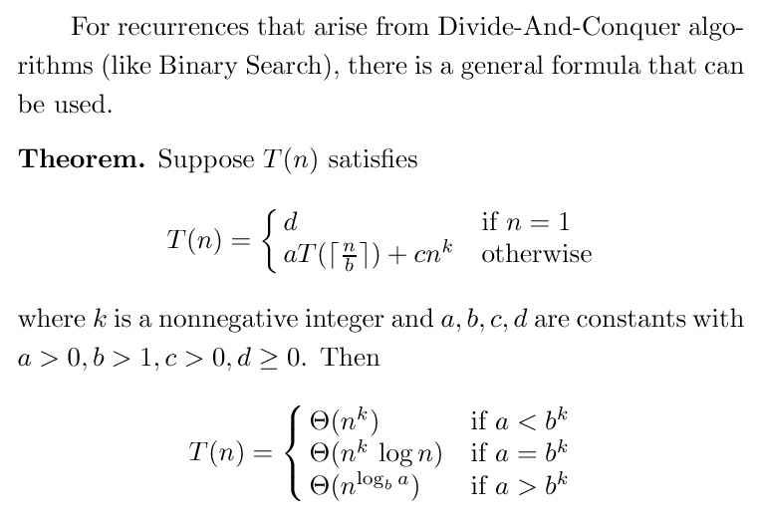
The Master Formula
Analysis of Algorithms

Slide 87
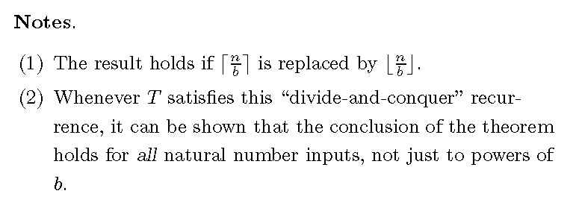
Master Formula (continued)
Analysis of Algorithms

Slide 88
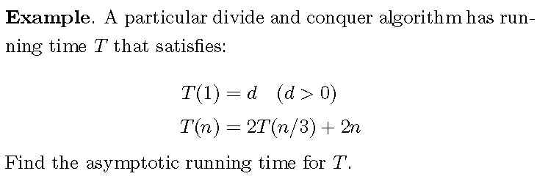
Master Formula (continued)
Analysis of Algorithms

Slide 89
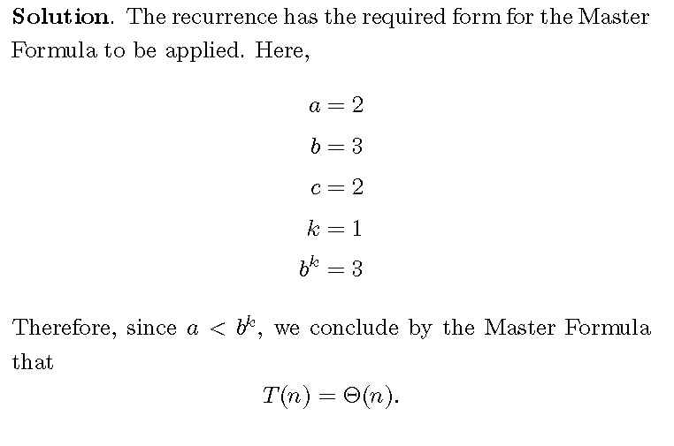
Master Formula (continued)
Analysis of Algorithms

Slide 90
Connecting the Parts of Knowledge
With The Wholeness of Knowledge
There are many techniques for analyzing the running time of a recursive algorithm. Most require special handling for special requirements (e.g. n not a power of 2, counting self-calls, verifying a guess).
The Master Formula combines all the intelligence required to handle analysis of a wide variety of recursive algorithms into a single simple formula, which, with minimal computation, produces the exact complexity class for algorithm at hand.
Analysis of Algorithms

Slide 91
3. Transcendental Consciousness is the field beyond diversity, beyond problems, and therefore is the field of solutions.
4. Impulses Within The Transcendental Field. Impulses within this field naturally form the blueprint for unfoldment of the highly complex universe. This blueprint is called Ved.
5. Wholeness Moving Within Itself. In Unity Consciousness, solutions to problems arise naturally as expressions of one’s own unbounded nature.
Analysis of Algorithms

